Slide 1
Vermont Emergency Management Presentation
Resiliency Conference
October 15, 2022
Notes:
Introduce Ben and Erica

Slide 2
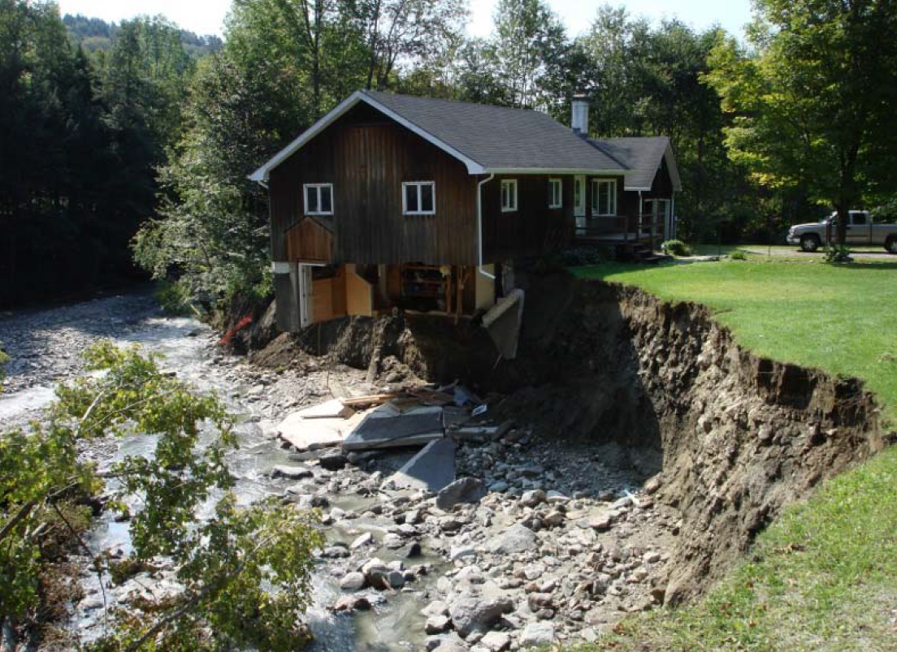
Notes:
Does it matter?
Flood related erosion is the hazard here…, and as it turns out is the primary mode of flood damage in Vermont

Slide 3
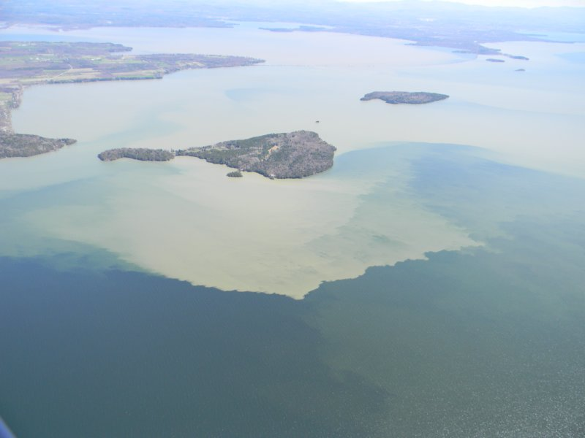
Sediment plumes from Lamoille and Winooski Rivers entering Lake Champlain April 2011. (Photo courtesy of Lake Champlain Basin Program)

Slide 4
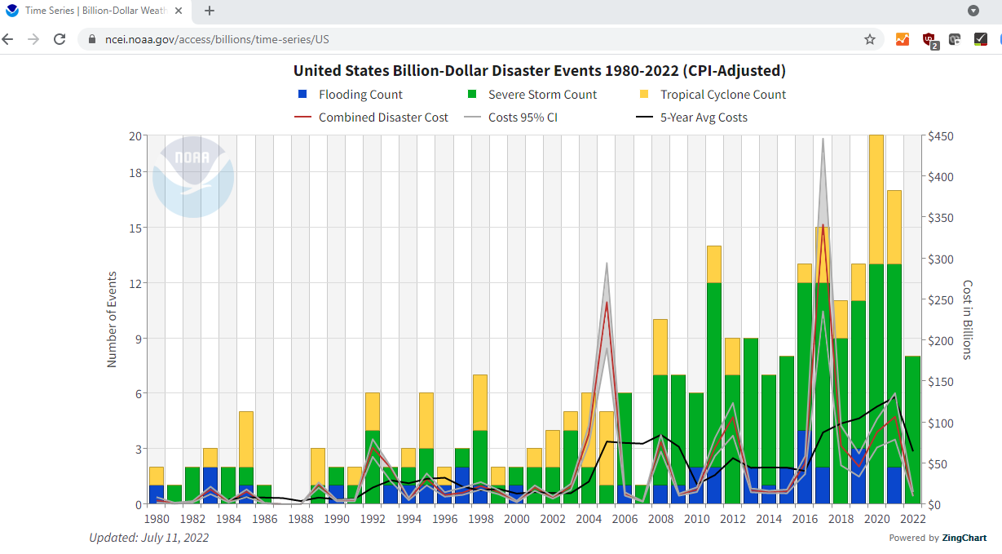
before Ian
Notes:
https://www.ncei.noaa.gov/access/billions/time-series/US
Chart from 9/30/2022 – as Hurricane Ian approaches SC after sweeping across FL.

Slide 5
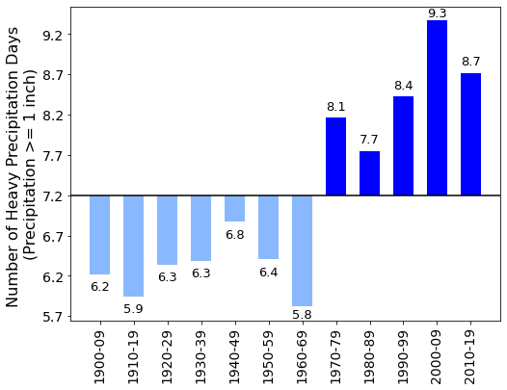
Notes:
https://site.uvm.edu/vtclimateassessment/chapters/water-resources/#h3.2

Slide 6
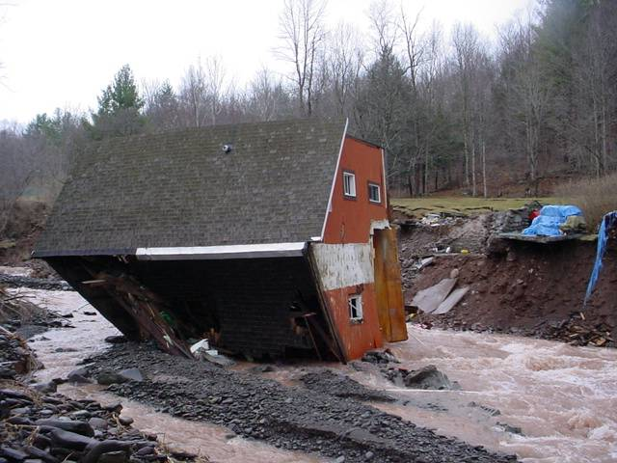
How can we avoid losses due to flooding?
Develop data to identify inundation and erosion hazards.
Provide model regulations
Develop incentives for communities.
Regulations to avoid known hazards, and to not aggravate the risk to structures, families, and assets already in the hazard zone.
Take steps to reduce existing exposure, and improve emergency response.
Make a family plan.
Prepare an emergency kit.
Practice the plan.
Get insurance.
Get finances in order.
Elevate structure.
Relocate structure.
Notes:
Act 110 (2010) – River Corridors and incentives

Slide 7
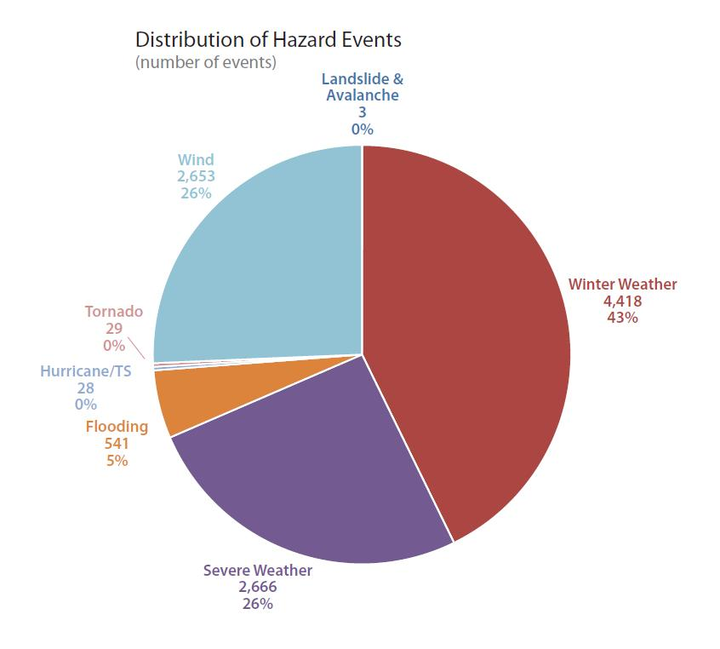

Slide 8
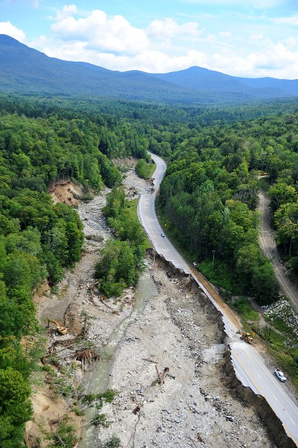
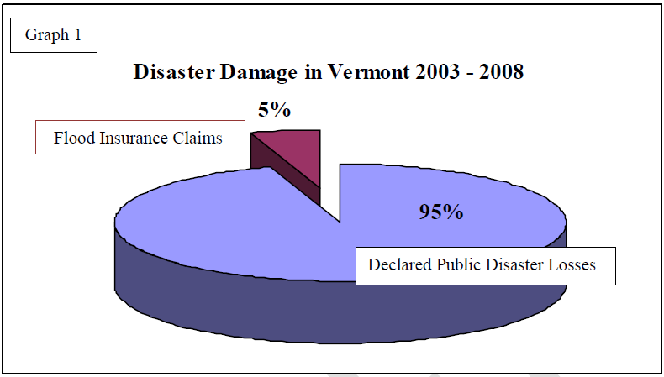

Slide 9
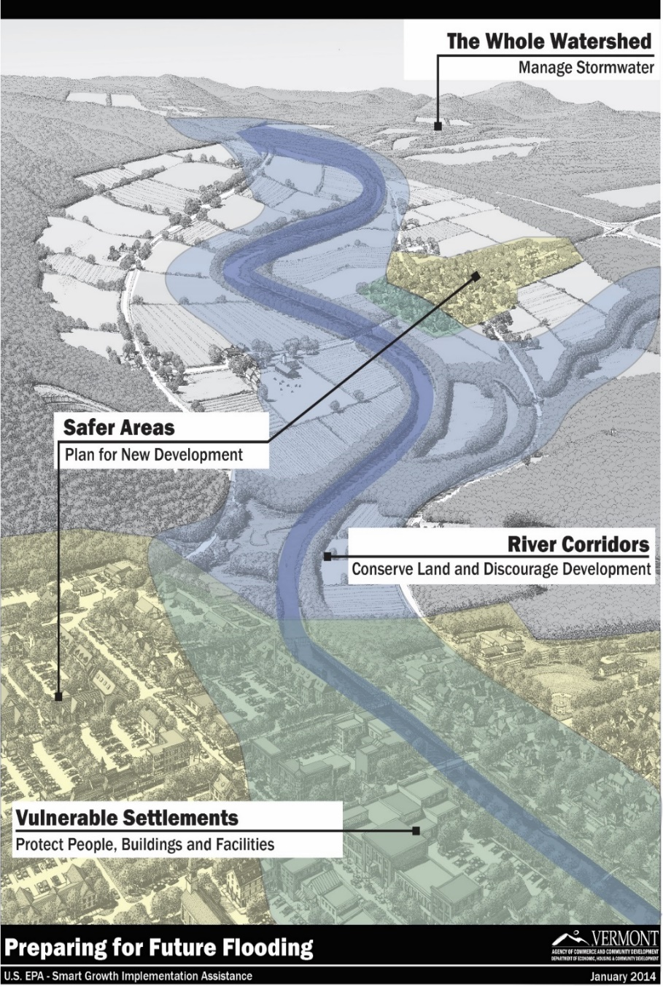
Applying lessons learned from Irene…
New River Corridor Maps
New Local Road Standards incorporating stormwater management
Flood Resilience in State, Regional, and Municipal Plans
Vermont Economic Resilience Initiative (VERI) – protecting businesses and the economy
Emergency Relief Assistance Funds (ERAF) – provides municipal incentives
Floodready Vermont - Easy transparent access to Information
Notes:
The following slides will touch on some of the main actions we are taking as a state, to meet those needs and to become more resilient to flooding and other climate-related hazards.
The graphic on this slide was produced through the EPA SGIA project, shows how the complexities of our flood resilience objectives are communicated through a landscape or watershed perspective, recognizing we can’t move all our historic settlements out of harm’s way

Slide 10
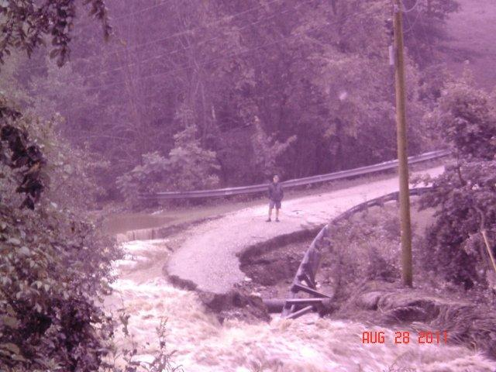
Where are your River Corridors and Floodplains? What is Already at Risk?
Protect What Works and Avoid Aggravating the Problem
Work Toward Reliable Roads and Reducing Risk
Prepare for Emergency
Insure Residual Risk
Notes:
Hazard Assessments
Special Flood Hazard Areas,
Fluvial Erosion Hazard Corridors
Setbacks
Flood Hazard Area Regulations
Hazard Mitigation Plan
Emergency Operations Plan

Slide 11
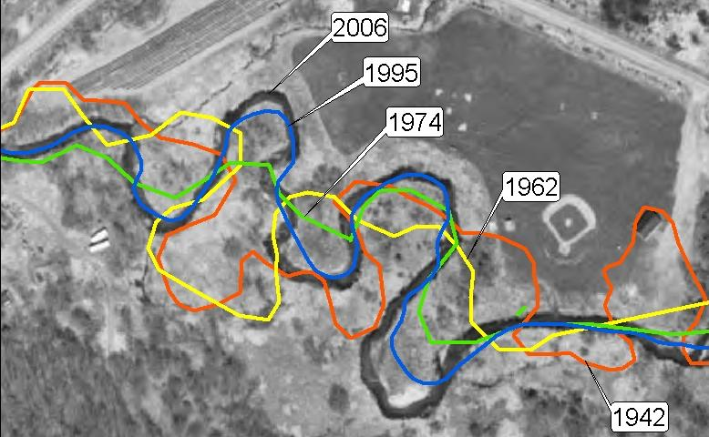
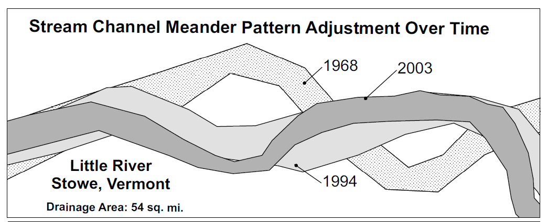
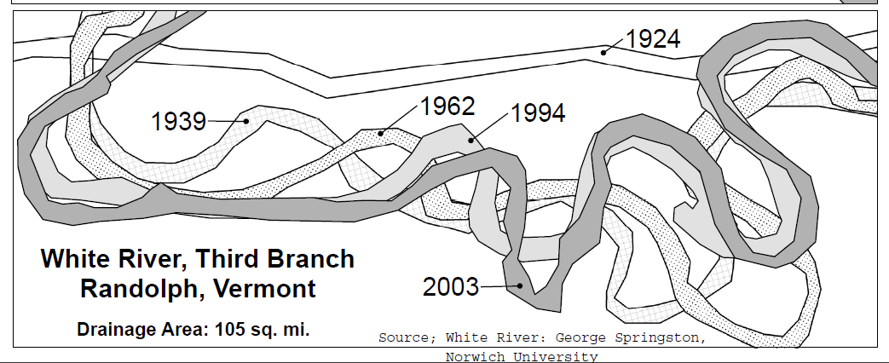
Rivers Need Room
Notes:
We’ve seen that rivers adjust laterally into adjacent lands. This meandering is natural in a stable river, and can be critical in an unstable river’s attempt to rebuild floodplain and regain equilibrium.

Slide 12
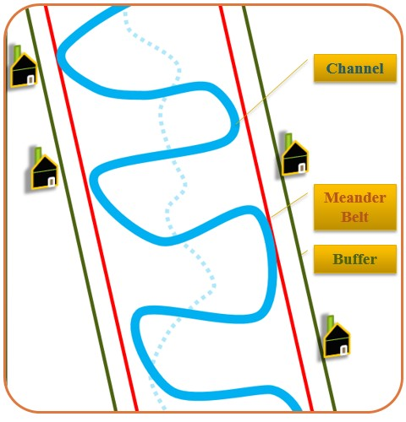
The River Corridor includes the meander belt and
an area for a stable bank.

Slide 13
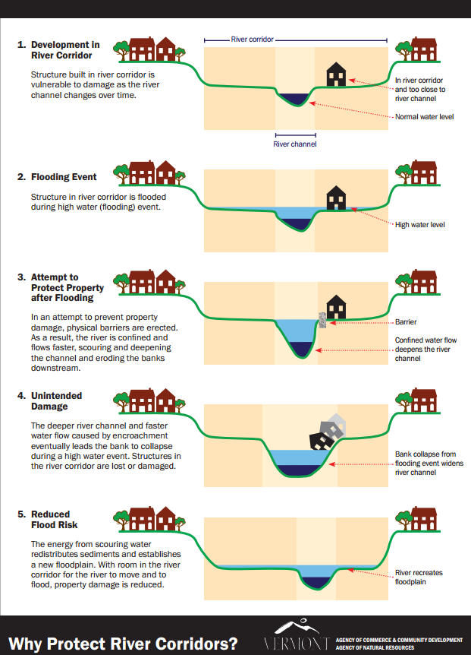
House placed too close to stream!
House damaged by water and erosion
Bank armoring to protect house.
Stream energy digs channel deeper.
Stream bank fails.

Slide 14
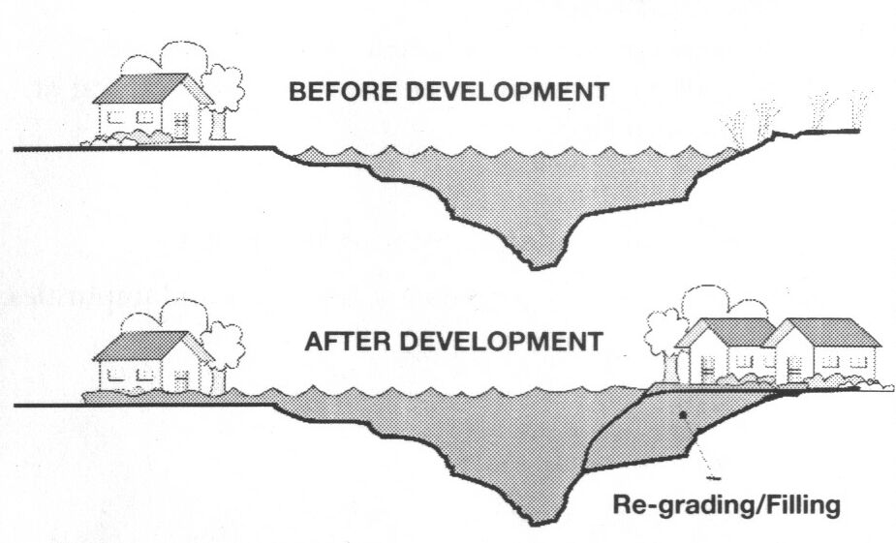
Why not add fill in a flood hazard area?
Fill deflects flood waters toward and onto other land
Increases flood water heights, power, and erosive damage.

Slide 15
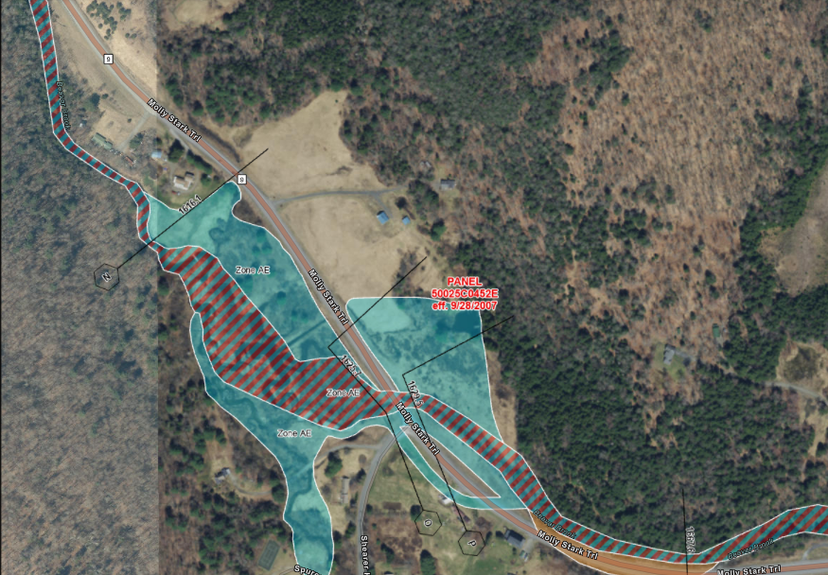
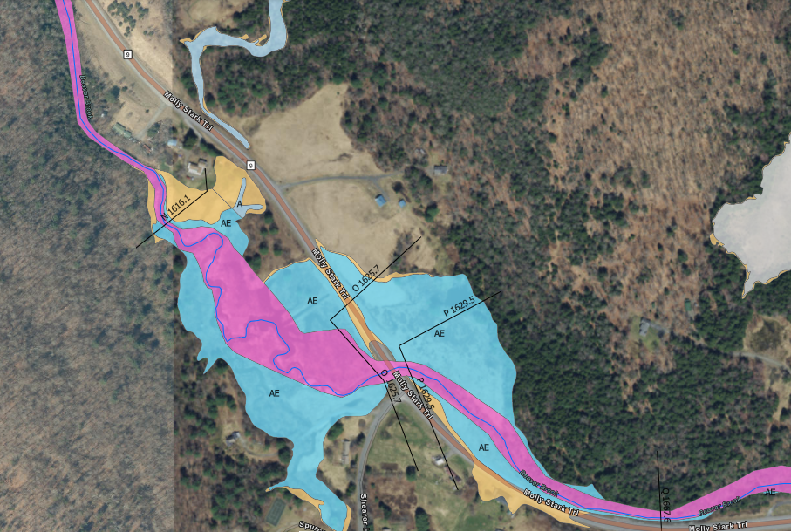
Effective FIRM
Draft Work Map for next FIRM

Slide 16
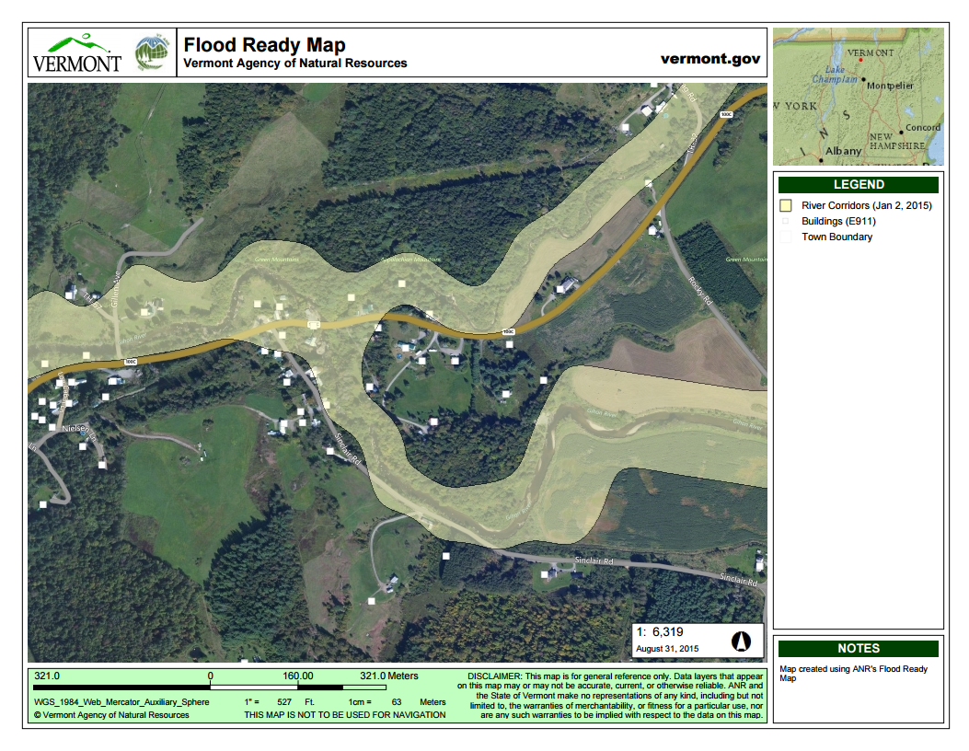
Flood Ready Atlas bit.ly/floodatlas

Slide 18
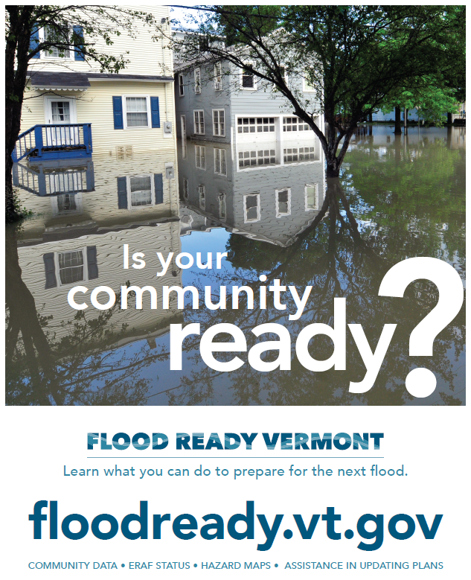

Slide 19
Vermont Economic Resiliency Initiative (VERI)
Follow-up actions
•Barre – developed plans to buyout homes and restore floodplain to protect the neighborhood and downtown from future floods. Voted to create a $500,000 local fund for resilience project. Applied for $750,000+ in HMGP funding to implement 7 residential acquisitions (“buy-outs”) per the VERI recommendations.
•Brattleboro – pursued recommendations to protect a key 12 acre parcel and increase its capacity to store flood water and debris and protect downtown business…
•Brandon -- designed an overflow culvert to protect the downtown municipal offices and business from floods and ensure State Route 7 is open for business.
•Enosburg -- included VERI recommendations in its Hazard Mitigation Plan, to ensure access to future HMGP funds. Secured partial funding to move a salt shed out of the floodway.
•Woodstock -- upgrading culverts and bridges.
Notes:
Four of the five VERI target communities have taken concrete actions or are endeavoring to do so through federal Hazard Mitigation grant-funded projects…

Slide 20
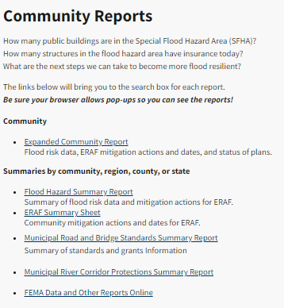
floodready.vermont.gov/assessment/community_reports

Slide 21
Equity-Centered Process for Environmental Justice
Who is most at risk?
Who is not at the table?
Meaningful engagement
Establishing trusting relationships
What can be prioritized to reduce harm?
Are we transparent and accountable?

Slide 22
Resilience in Emergency management

Slide 23
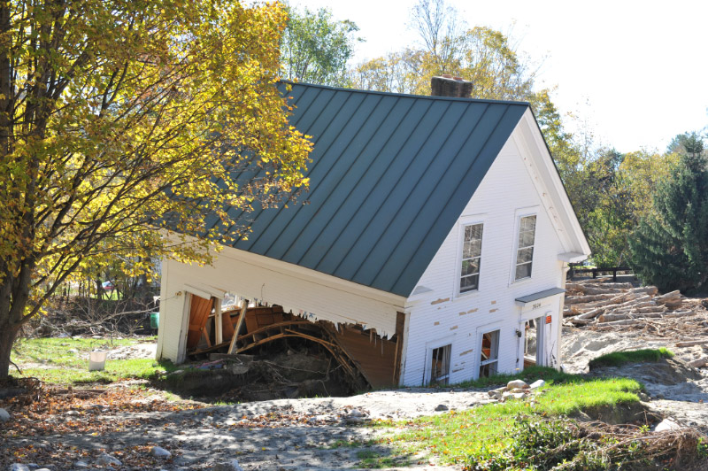
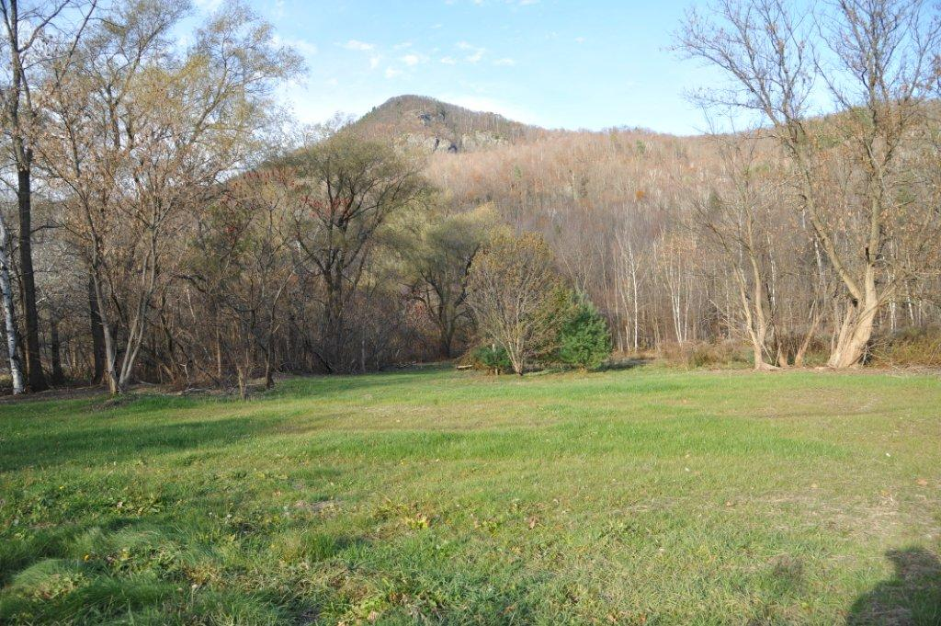
buyouts
Notes:
With the $34.5 million of available HMGP funding from Irene, we allocated more than $20 million to buy-outs of homes in flood vulnerable locations. Many of those were homes that had been destroyed by Irene, so there was a human co-benefit of getting these homes demolished and “giving those places back to the river.”

Slide 24
Brattleboro floodplain restoration
Notes:
An example is the big, ambitious, multi-phase mitigation vision of improving co-existence between the Whetstone Brook and downtown Brattleboro…

Slide 25
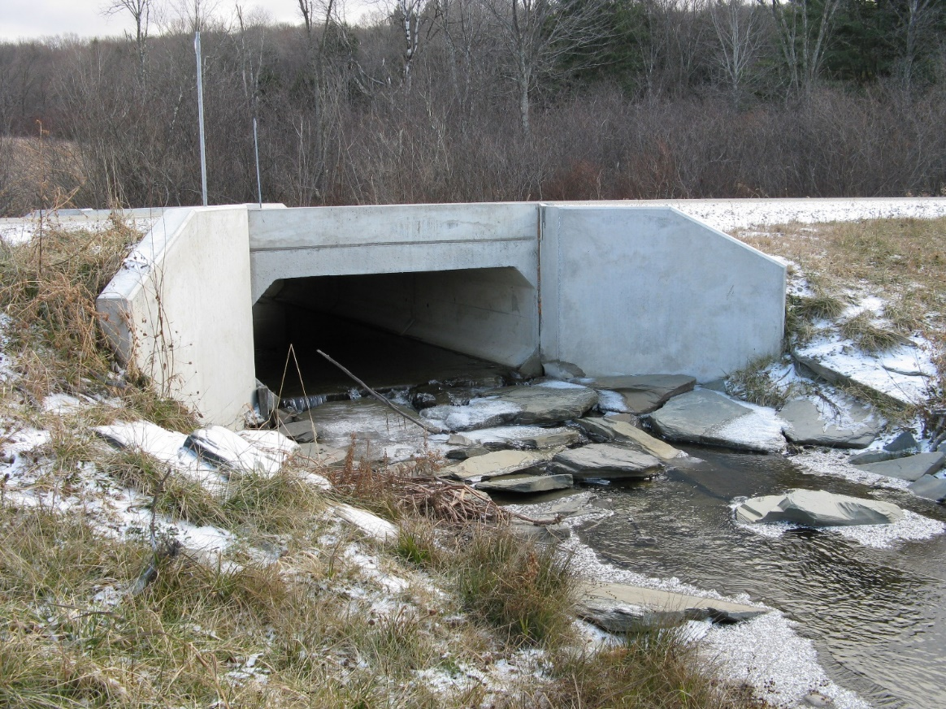
Other infrastructure projects
Culvert Upsizing
Road Relocation
Generators for Critical Facilities
Floodplain Restoration
Streambank Reinforcement
Structural Elevation
Planning
5% Initiative
Notes:
Other eligible projects include pro-actively upgrading undersized drainages, and removing historical fill to help rivers recover access to their floodplains. Again, there are conservation co-benefits (e.g. for fish passage through larger bottomless culverts, and for riverine habitat restoration).

Slide 26
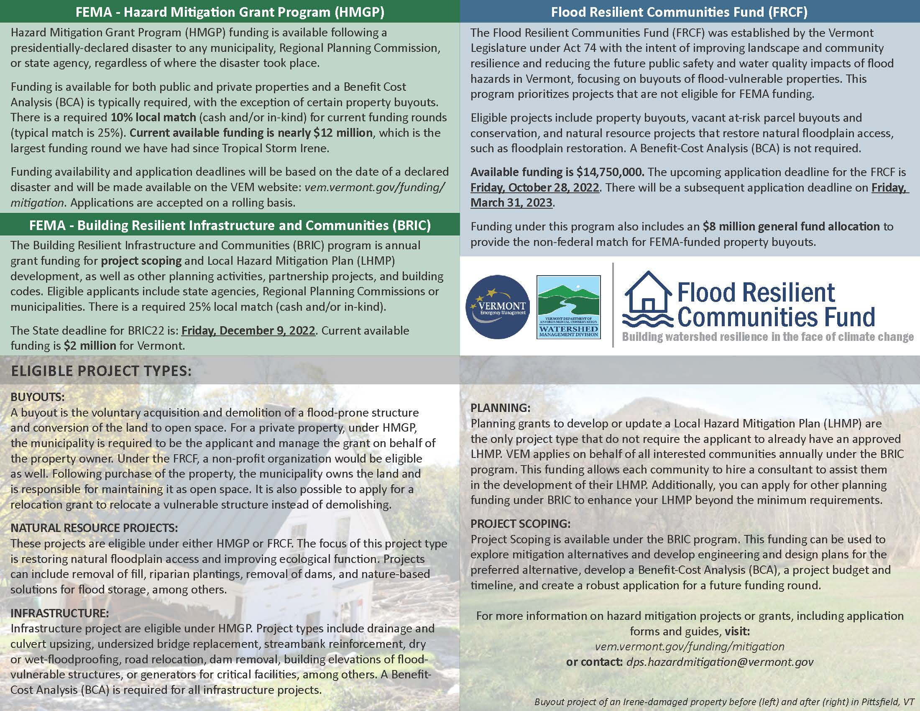
UPDATE>>>Upcoming hazard mitigaton funding opportunities
January 27, 2020: Pre Disaster Mitigation deadline for FFY’19 egrants submittals.
Up to $575K for local hazard mitigation planning and project development (Chester), and a buy-out in Bolton;
$1.8M federal share for 9 buy-outs in Huntington following Halloween Storm (must compete for national funds).
April 3, 2020: Hazard Mitigation Grant Program applications due for DR4445 funding (April 15, 2019 flooding). Approximately $1 million federal share
Buy-outs possible in Huntington, Underhill, Starksboro, Ludlow…
December, 2020?: Hazard Mitigation Grant Program applications for Halloween Storm (assuming a declaration soon). Approximately $750K?
January, 2021?: First round of “BRIC” (Building Resilient Infrastructure and Communities), the new expanded version of Pre Disaster Mitigation.

Slide 27
Hazard mitigation contacts
Ben Rose | Recovery and Mitigation Section Chief
(802) 241-5363 | ben.rose@vermont.gov
Stephanie A. Smith | Hazard Mitigation Planner
(802) 241-5362 | Stephanie.A.Smith@vermont.gov

Slide 28
Climate mitigation vs. climate adaptation
“Mitigate” climate change:
“Adapt” to climate change:
Refers to efforts to reduce or prevent emission of greenhouse gases
The process of adjustment to actual or expected climate and its effects
Notes:
See next slide

